Slide 1

Team Name : NinzaNova
Team Leader Name : Aditya Chauhan
Team Members: Supreeth Chandrashekhar, Bharath Shivashankar
Problem Statement: Personalised Trip Planner with AI

Slide 2
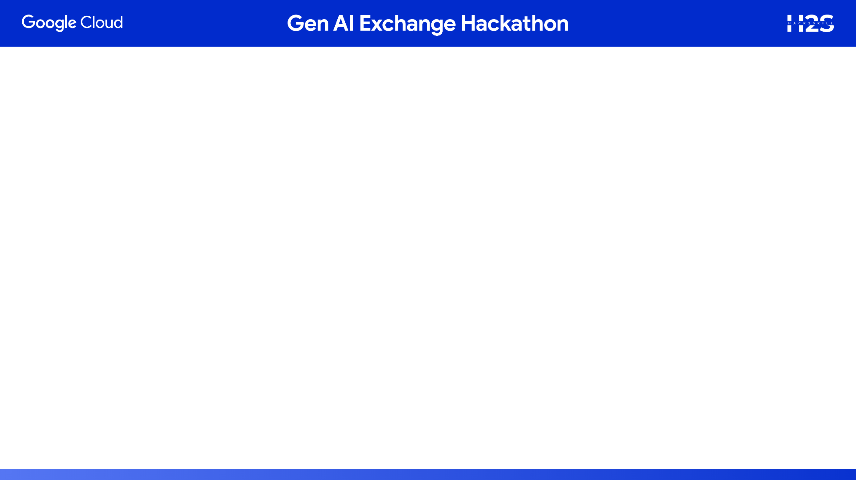
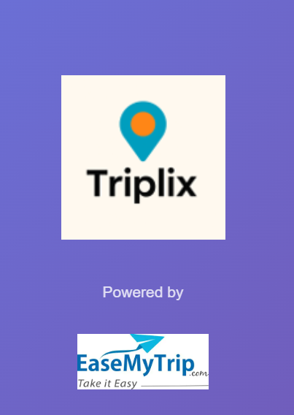
Triplix – AI Travel Assistant
Your Smart Travel Companion Powered by Google AI
Tagline:
"Plan & Book Your Dream Trip in Minutes, Not Hours"
What is Triplix?
Triplix is a next-gen AI-powered travel assistant that transforms trip planning into a fast, personalized, and enjoyable experience. It combines:
AI Chat + Voice Input for natural, conversational planning
Swipe-Based Selection for hotels, transport & destinations (Tinder-style)
Real-Time Flight/Train Suggestions with live data
Google Maps Integration for location-based planning
Day-by-Day Itinerary Builder with AI optimization
Continuous Learning from user preferences
Mock Booking System with PNRs, booking IDs & payment summary
Hack2Skill Hackathon 2025 | Team Triplix | Powered by Google Technologies

Slide 3
Core Innovation
Unlike traditional travel apps, Triplix offers:
Voice & Text AI – Just talk to Triplix like a friend
Swipe to Decide – Make quick, visual choices
AI Does the Work – Personalized suggestions based on your style
Learns from You – Gets smarter with every swipe
Built With Google Technologies
Gemini 2.0 Flash AI – Multi-agent architecture for personalization
Google Maps API – Real-time location services
Flutter – Cross-platform mobile development
Firebase – Real-time sync & authentication
Google Cloud (Ready) – Scalable backend infrastructure
Footer:

Slide 4
Slide Title: Innovation, Impact & Alignment
What’s New
  AI + Swipe: No filters, just swipe to choose
  Multi-Agent Chat: One chat handles all planning
  Real-Time Transport: AI generates flights/trains instantly
  Voice Planning: Speak your trip, AI does the rest
  Checkpoint traker, so tha you have entered all the information properly.
Theme Fit
Uses Gemini AI for chat, voice, personalization
Fully aligned with Conversational AI for Travel
Who Benefits
Families: No more planning stress
Professionals: Plan in 5 minutes
New Travelers: Trusted suggestions
Economic: Save ₹5K–₹10K + time

Slide 5
Working product & demo
Does the full journey run end-to-end without breaking?
Link to your demo video (3 min) showcasing walkthrough of your product & its features

Slide 6
Process Flow (user journey)
1. Voice/Text Query → "Plan trip to Goa"
Value: Instant understanding
2. Swipe Hotels → Accept 2/5 options
Value: Visual, quick decisions
3. Swipe Transport → AI shows 6 options (flights/trains)
Value: Real options with prices
4. Swipe Destinations → Pick activities
Value: Curated attractions
5. AI Generates Itinerary → 15-20 seconds
Value: Complete day-by-day plan
6. Book Everything → Animated confirmation
Value: Booking IDs, PNRs, payment summary
Total time: 5 minutes

Slide 7
Architecture Diagram
What are the main parts behind the scenes?
How do these parts talk to each other?

Slide 9
DATA STORAGE (Current: Mock)
├─ In-Memory State (Session-based)
├─ JSON Data Structures
└─ Future: Firebase / PostgreSQL
DEVELOPMENT TOOLS
├─ VS Code (IDE)
├─ Git (Version control)
├─ GitHub (Code hosting)
├─ Postman (API testing)
└─ Chrome DevTools (Debugging)
DEPLOYMENT (Current: Local)
├─ FastAPI: localhost:8001
├─ Flutter: Android Emulator / Real device
└─ Future: Cloud hosting
Tech Stack
┌────────────────────────────────────────────────────────────┐
│ TECH STACK OVERVIEW │
└────────────────────────────────────────────────────────────┘
FRONTEND (Mobile & Web)
├─ Flutter 3.16+ (Cross-platform framework)
├─ Dart (Programming language)
├─ Provider (State management)
├─ HTTP Client (API communication)
├─ flutter_card_swiper (Swipe interface)
├─ google_fonts (Typography)
└─ Material Design 3 (UI components)
BACKEND (API Server)
├─ FastAPI (Python web framework)
├─ Python 3.10+ (Runtime)
├─ Uvicorn (ASGI server)
├─ Pydantic (Data validation)
├─ asyncio (Async processing)
└─ CORS Middleware (Cross-origin support)
GOOGLE AI INTEGRATION
├─ Gemini 2.0 Flash Experimental
│ └─ google-generativeai library (Python SDK)
├─ API Key Authentication
├─ Temperature: 0.7 (balanced creativity)
├─ Max Tokens: 8000 (long-form generation)
└─ Safety Settings: Default

Slide 10
User Experience
Can a first-time user complete the main task quickly and comfortably?
Is it easy to use on phone and desktop with clear messages?

Slide 11
Market & Adoption
Who will use it first, and how will you reach them?
What is the monthly cost to run, and is it sensible?
What are you next 30-90 days (try/launch/measure)?

Slide 12
To be implemented for the future:
Group contrinuting Agent.
Which will handle the swipes in contribution and will give the common itennary, for the group (10 members max).
Imtegrate the Mail for the notifications
Who will use it first, and how will you reach them?
What is the monthly cost to run, and is it sensible?
What are you next 30-90 days (try/launch/measure)?

Slide 13
To be implemented for the future:
Group contrinuting Agent.
Which will handle the swipes in contribution and will give the common itennary, for the group (10 members max).
Include the firebase or firestore service, instead of the local storage.
Real time tracking and the notification as per the Google calender.

Slide 14


